Slide 1
Software Design and Architecture
Foundation of Design Patterns

Slide 2
Design principles
High-level principles
‣ Single Responsibility
‣ Open/Closed
‣ Liskov Substitution Principle
‣ Interface Segregation
‣ Dependency Inversion
Low-level principles that can help guide design decisions.
‣ Encapsulate what varies
‣ Program to interfaces, not implementations
‣ Favor composition over inheritance
‣ Strive for loose coupling

Slide 3
Problem
Related objects need to communicate with each other to maintain consistency.

Slide 4
Solution
The Observer Pattern defines a one to many dependency between objects so that when one object changes state, all of its dependents are notified and updated automatically.

Slide 5
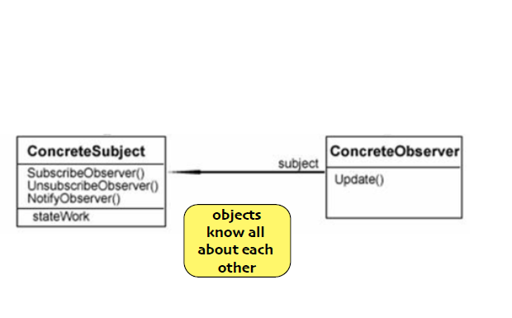
How it was

Slide 6
Design Principle
Strive for Loosely coupled designs between objects that interact

Slide 7
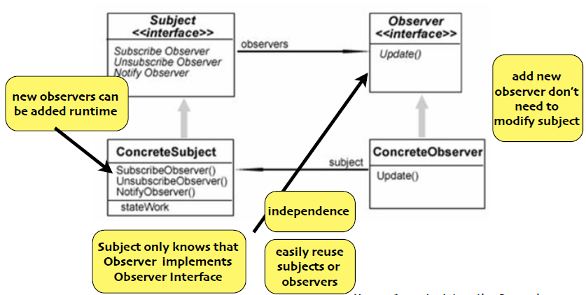
Design

Slide 8
Baby Monitor
Suppose we implement a simple Baby Monitoring System using the Observer pattern with 1 baby and 2 different types of Monitors (simple, advanced).
Babies can cry at 3 different levels (sobbing, crying, screaming).
The simple monitor can only notify its user that the baby is crying.
The advanced monitor also indicates the level of crying.

Slide 9
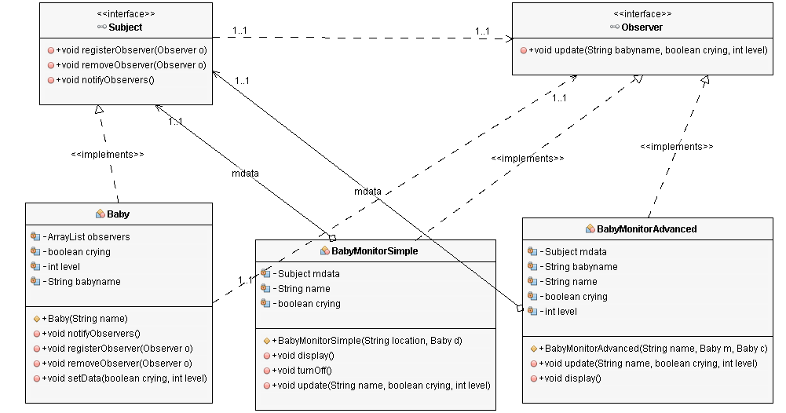
Baby Monitor

Slide 10
Interface
public interface Subject {
public void registerObserver(Observer o);
public void removeObserver(Observer o);
public void notifyObservers();
}
public interface Observer {
public void update(String babyname, boolean crying, int level);
}

Slide 11
Subject
public class Baby implements Subject {
private ArrayList observers;
private boolean crying=false;
private int level=0;
private String babyname;
public Baby(String name){
this.babyname=name;
observers=new ArrayList();
}
public void notifyObservers() {
for (int i=0; i< observers.size(); i++) {
Observer observer = (Observer) observers.get(i);
observer.update(babyname, crying, level);
}
}
public void registerObserver(Observer o) {
observers.add(o);
}
public void removeObserver(Observer o) {
int i = observers.indexOf(o);
if (i >=0) {
observers.remove(i);
}
}
public void setData(boolean crying, int level) {
this.crying=crying;
this.level=level;
notifyObservers();
}
}

Slide 12
Simple Monitor
public class BabyMonitorSimple implements Observer {
private Subject mdata;
private String name;
private boolean crying;
public BabyMonitorSimple(String location, Baby d) {
this.mdata=d;
this.name=location;
mdata.registerObserver(this);
}
public void display() {
if (crying) {
System.out.println("Monitor:" + name + " baby is crying");
}
}
public void turnOff() {
mdata.removeObserver(this);
}
public void update(String name, boolean crying, int level) {
this.crying=crying;
display();
}
}

Slide 13
Advanced Monitor
public class BabyMonitorAdvanced implements Observer {
private Subject mdata, cdata;
private String babyname;
private String name;
private boolean crying;
private int level;
public BabyMonitorAdvanced(String name, Baby m, Baby c) {
this.name=name; this.mdata=m; this.cdata=c;
mdata.registerObserver(this);cdata.registerObserver(this);
}
public void update(String name, boolean crying, int level) {
this.babyname=name;
this.crying=crying;
this.level=level;
display();
}
public void display() {
if (crying) {
System.out.println("Monitor:"+ name + " baby: " + babyname + " is crying at level: " + level);
}
}
}

Slide 14
Test
class TestBabyMonitor {
public static void main(String[] args) {
Baby marla = new Baby("marla");
// one monitor with one baby
BabyMonitorSimple livingRoom = new BabyMonitorSimple("kitchen ", marla);
marla.setData(true, 1);
// one monitor listening to two babies
Baby charlie = new Baby("Charlie");
BabyMonitorAdvanced kitchen = new BabyMonitorAdvanced("Living room ", marla, charlie);
marla.setData(true, 2);
charlie.setData(true,1);
}
}
Output
Monitor:kitchen baby is crying
Monitor:kitchen baby is crying
Monitor:Living room baby: marla is crying at level: 2
Monitor:Living room baby: Charlie is crying at level: 1

Slide 15
Push vs Pull
- All the data gets
pushed all the
Time
+ every observer
has all the latest
data
- May need
multiple calls to
get all the data
+ more flexibility
let observers figure
it out themselves

Slide 16
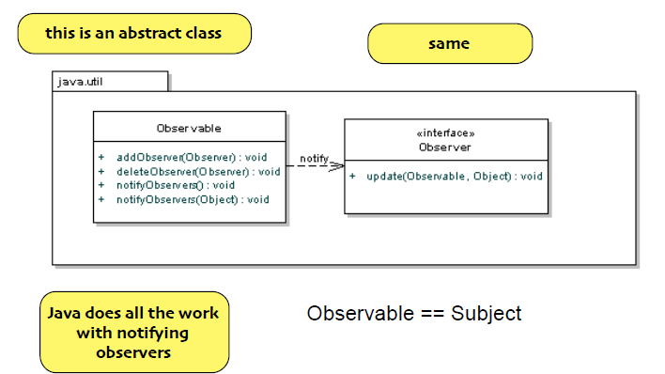
Java Observable

Slide 17
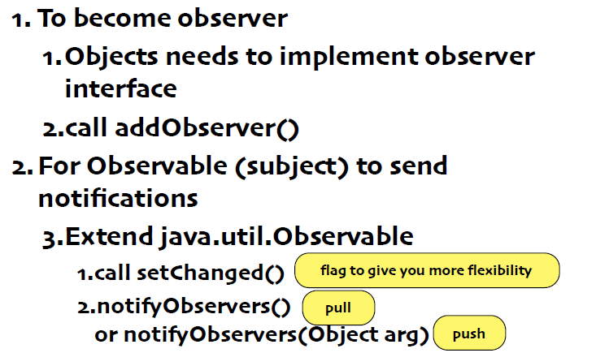
Steps

Slide 18
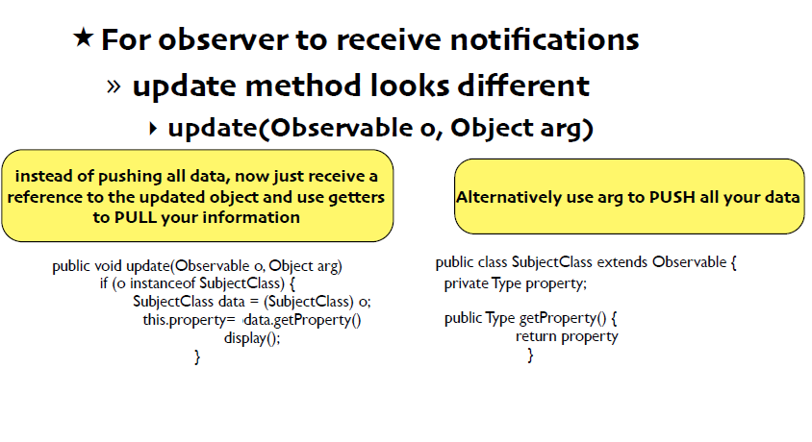
Steps

Slide 19
Limitations
Observable is class not interface
Can’t use multiple inheritance
Setchanged() is protected
you must subclass to be able to call it
violates favor composition over inheritance
Order in which Observers are updated may differ from your own implementation

Slide 20
Delegation
When designing a class, there are four ways to handle an incoming message
Handle message by implementing code in a method
Let the class’s superclass handle the request via inheritance
Pass the request to another object (delegation)
some combination of the previous three

Slide 21
Delegation
Delegation is employed when some other class already exists to handle a request that might be made on the class being designed
The host class simply creates a private instance of the helper class and sends messages to it when appropriate
As such, delegation is often referred to as a “HAS-A” relationship

Slide 22
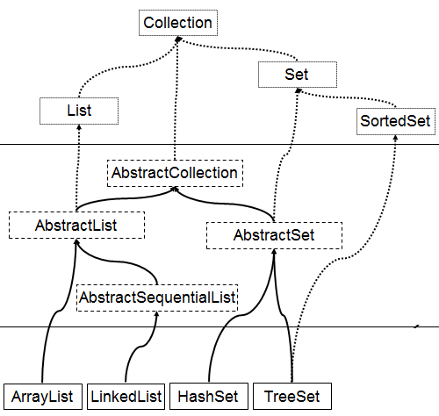
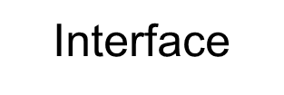
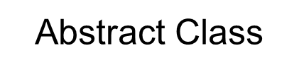
Java Collection

Slide 23
GroceryList
delegates all
of its work to
Java’s
LinkedList
class (which
it accesses
via the List
interface).
import java.util.List;
import java.util.LinkedList;
public class GroceryList {
private List<String> items;
public GroceryList() {
items = new LinkedList<String>();
}
public void addItem(String item) {
items.add(item);
}
public void removeItem(String item) {
items.remove(item);
}
public String toString() {
String result = "Grocery List\n------------\n\n";
int index = 1;
for (String item: items) {
result += String.format("%3d. %s", index++, item) + "\n";
}
return result;
}
}

Slide 24
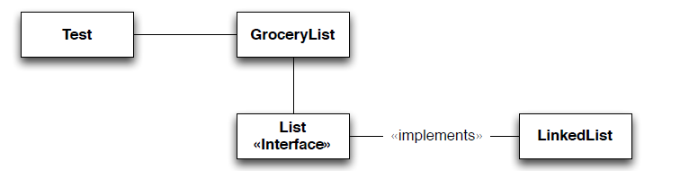
public class Test {
public static void main(String[] args) {
GroceryList g = new GroceryList();
g.addItem("Granola");
g.addItem("Milk");
g.addItem("Eggs");
System.out.println("" + g);
g.removeItem("Milk");
System.out.println("" + g);
}
}
With the delegation, We get a nice abstraction in our client code. We can create grocery lists, add and remove items and get a printout of the current state of the list.
GroceryList needs “list like” functionality. So, internally, it uses a LinkedList (via a List interface). This is hidden from Test which just sees a “grocery list” with a nice abstraction.

Slide 25

import java.util.List;
import java.util.LinkedList;
public class TestWithout {
public static void printList(List<String> items) {
System.out.println("Grocery List");
System.out.println("------------\n");
int index = 1;
for (String item : items) {
System.out.println(String.format("%3d. %s", index++, item));
}
System.out.println();
}
public static void main(String[] args) {
List<String> g = new LinkedList<String>();
g.add("Granola");
g.add("Milk");
g.add("Eggs");
printList(g);
g.remove("Milk");
printList(g);
}
}
Without delegation, we get less abstraction. We’re using the List interface directly with its method names and We have to create a static method to handle the printing of the list rather than using toString().

Slide 26
Delegation
Now, the two programs (with delegation and without delegation) produce exactly the same output.
Benefits of Delegation
Better abstraction
Less code in classes we write ourselves
We can change delegation relationships at runtime!
Unlike inheritance relationships

Slide 27
Delegation
Changing delegation relationships at run-time
A class can use a set at run-time
Set<String> items = new HashSet<String>();
If the class suddenly needs to be sorted, it can do this
items = new TreeSet<String>(items);
We have changed the delegation to an entirely new object at run-time and now the items are sorted
In both cases, the type of items is Set<String> and we get the correct behavior via polymorphism

Slide 28
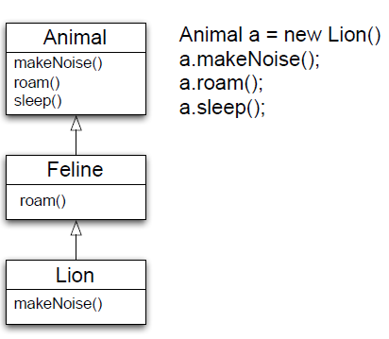
Polymorphism
a.roam() invokes Feline.roam() a.makeNoise() invokes Lion.makeNoise()
A message sent to Animal travels down the hierarchy looking for the “most speciﬁc” method body
In actuality, method lookup starts with Lion and goes up

Slide 29
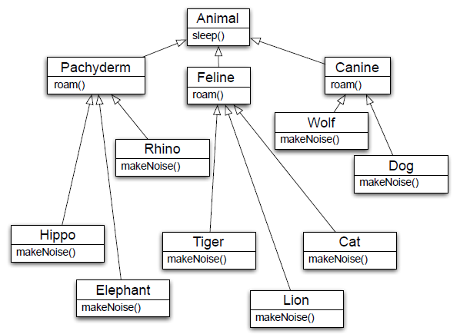
Polymorphism

Slide 30
Polymorphism
Polymorphism allows us to write very abstract code that is robust with respect to the creation of new subclasses
For instance
public void goToSleep(Animal[] zoo) {
for (int i = 0; i < zoo.length; i++) {
zoo[i].sleep();
}}
We don’t have to care what type of animals are contained in the array
We just call sleep() and get the correct behavior for each type of animal

Slide 31
Delegation
Summary
• Don’t re-invent the wheel… delegate!
• Delegation is dynamic (not static)
• delegation relationships can change at run-time
• Not tied to inheritance

Slide 32
Delegation
Delegation, as a design pattern, is used throughout the iOS and Cocoa frameworks
Basic pattern involving two objects
Host and delegate; use delegate to customize host
Define an interface that a delegate will implement
some methods are required; the rest are optional
Host will invoke methods on delegate as needed to influence its behavior

Slide 33
Beautify the following poorly designed Java program.
public class Bob {
public static void main(String[] args) {
Bob b = new Bob();
System.out.println(b.mood(1));
System.out.println(b.mood(2));
System.out.println(b.mood(3));
}
String mood(int mymood) {
switch (mymood) {
case 1:
return "Grumpy";
case 2:
return "OK";
case 3:
return "Happy";
default:
throw new RuntimeException("unknown mood");
}
}
}

Slide 34
Problem
Your program needs to support different kinds of behavior

Slide 35
Solution
The Strategy Pattern defines a family of algorithms, encapsulates each one and makes them interchangeable. Strategy lets the algorithm vary independently from clients that use it.

Slide 36
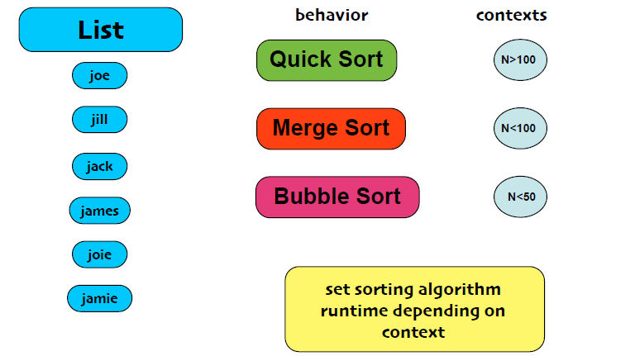
Example

Slide 37
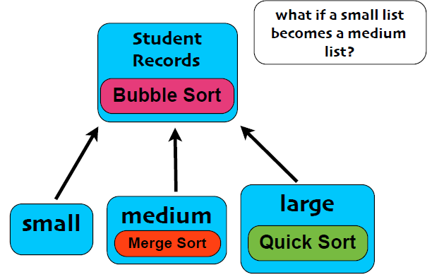
Naive approach

Slide 38
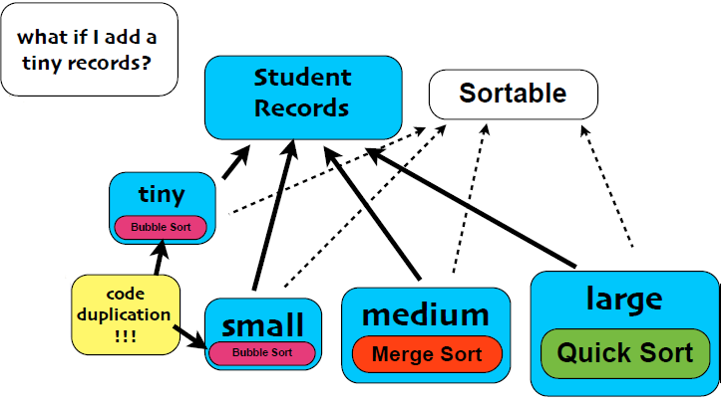
Add Interface?

Slide 39
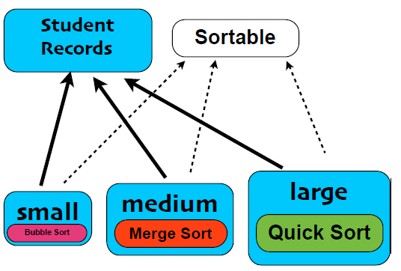
Add Interface

Slide 40
Design Principles
Encapsulate what varies
Program to interfaces, not implementations

Slide 41
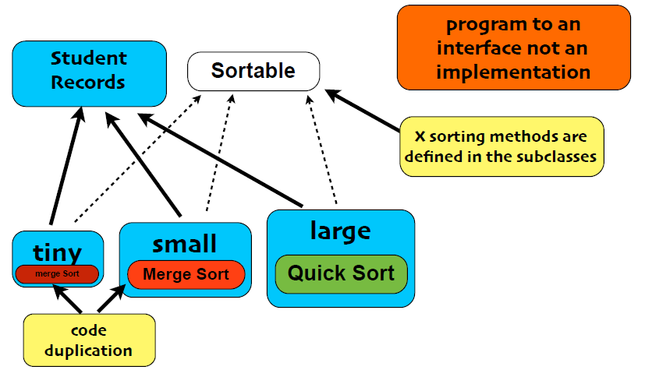
Program to Interface

Slide 42
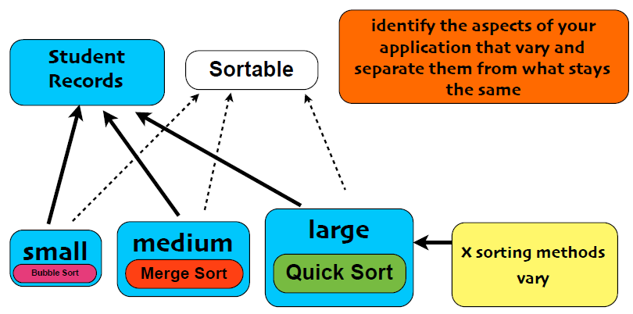
Program to Interface

Slide 43
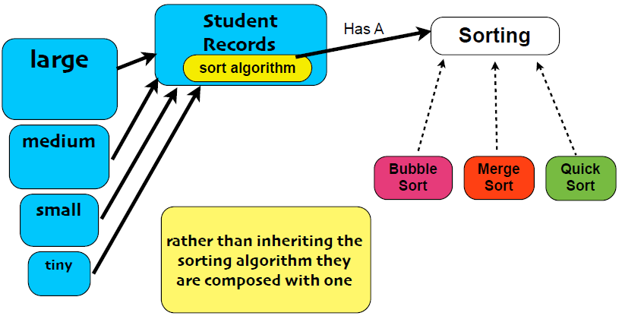
Program to Interface

Slide 44
Design Principles
Favor composition over inheritance

Slide 45
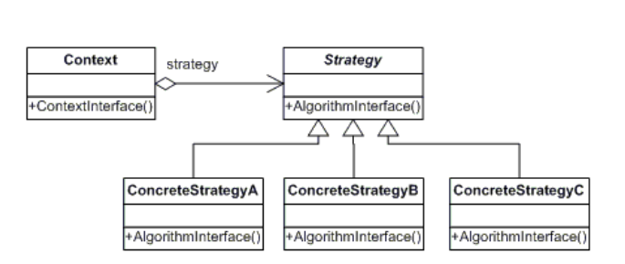
Solution
The Strategy Pattern ﬁrst identiﬁes the behaviors or algorithms that vary and separate them from the system that stays the same.
These behaviors or algorithms are encapsulated in classes that implement a common interface. This enables the developer to program to an interface and not an implementation.

Slide 46
Participants
Strategy declares an interface common to all supported algorithms. Context uses this interface to call the algorithm deﬁned by a ConcreteStrategy
ConcreteStrategy implements the algorithm using the Strategy interface
Context is conﬁgured with a ConcreteStrategy object maintains a reference to a Strategy object may deﬁne an interface that lets Strategy access its

Slide 47
Inclass Exercise
Microservice Architecture:
ACID properties and CAP Theorem

